Slide 1
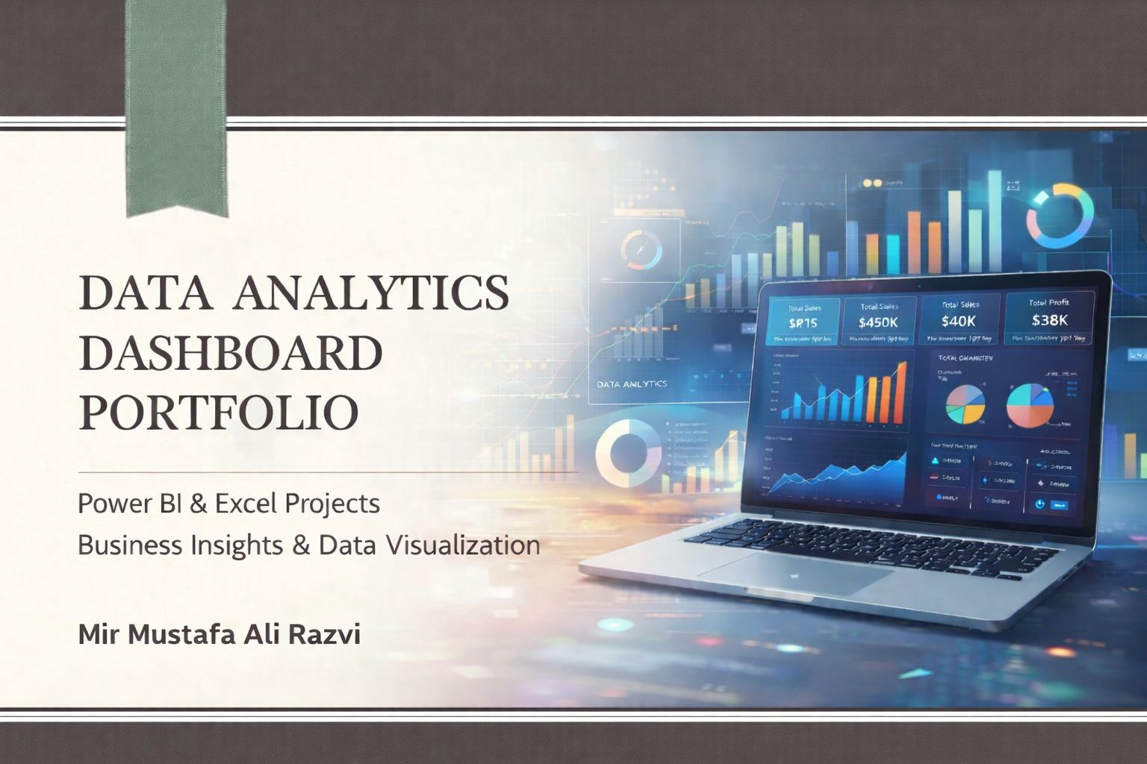

Slide 2

HR Analytics Dashboard – Overview & Role
Overview
Interactive HR analytics dashboard developed using Power BI
Purpose: To analyse employee attrition and workforce trends
Supports HR decision-making using data-driven insights
Department-wise analysis using slicers (HR, R&D, Sales)
Role:
Data cleaning & transformation
Data modeling and DAX calculations
Dashboard design & insight generation

Slide 3

HR Analytics Dashboard – Key Metrics & KPIs
Total Employee Count: 1.47K
Total Attrition Count: 237 employees
Overall Attrition Rate: 16.1%
Average Employee Age: 37 years
Average Salary: 6.5K
Average Years at Company: 7 years

Slide 4
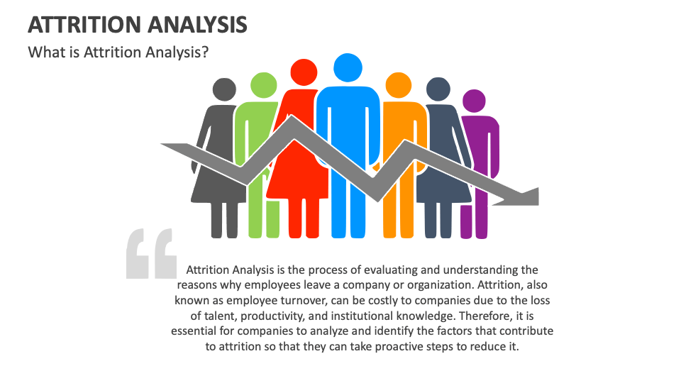
HR Analytics Dashboard – Attrition Analysis
Attrition by Age Group: Highest attrition observed in 26–35 age group
Attrition by Education: Life Sciences and Medical backgrounds show higher attrition
Attrition by Salary Slab: Employees earning up to 5K show maximum attrition
Attrition by Years at Company: Higher attrition during early years of employment

Slide 5

HR Analytics Dashboard – Job Role Insights
Job Role
High attrition observed in Laboratory Technicians and Sales Executives
Job role comparison helps identify critical roles with retention issues
Helps HR teams design role-specific retention strategies
Key Insights:
Highest attrition in 26–35 age group
Early-stage employees show higher attrition

Slide 6

HR Analytics Dashboard – Skills Used
Skills
Power BI
DAX
Data Modeling
HR Analytics
KPI Design
Business Decision Support

Slide 7
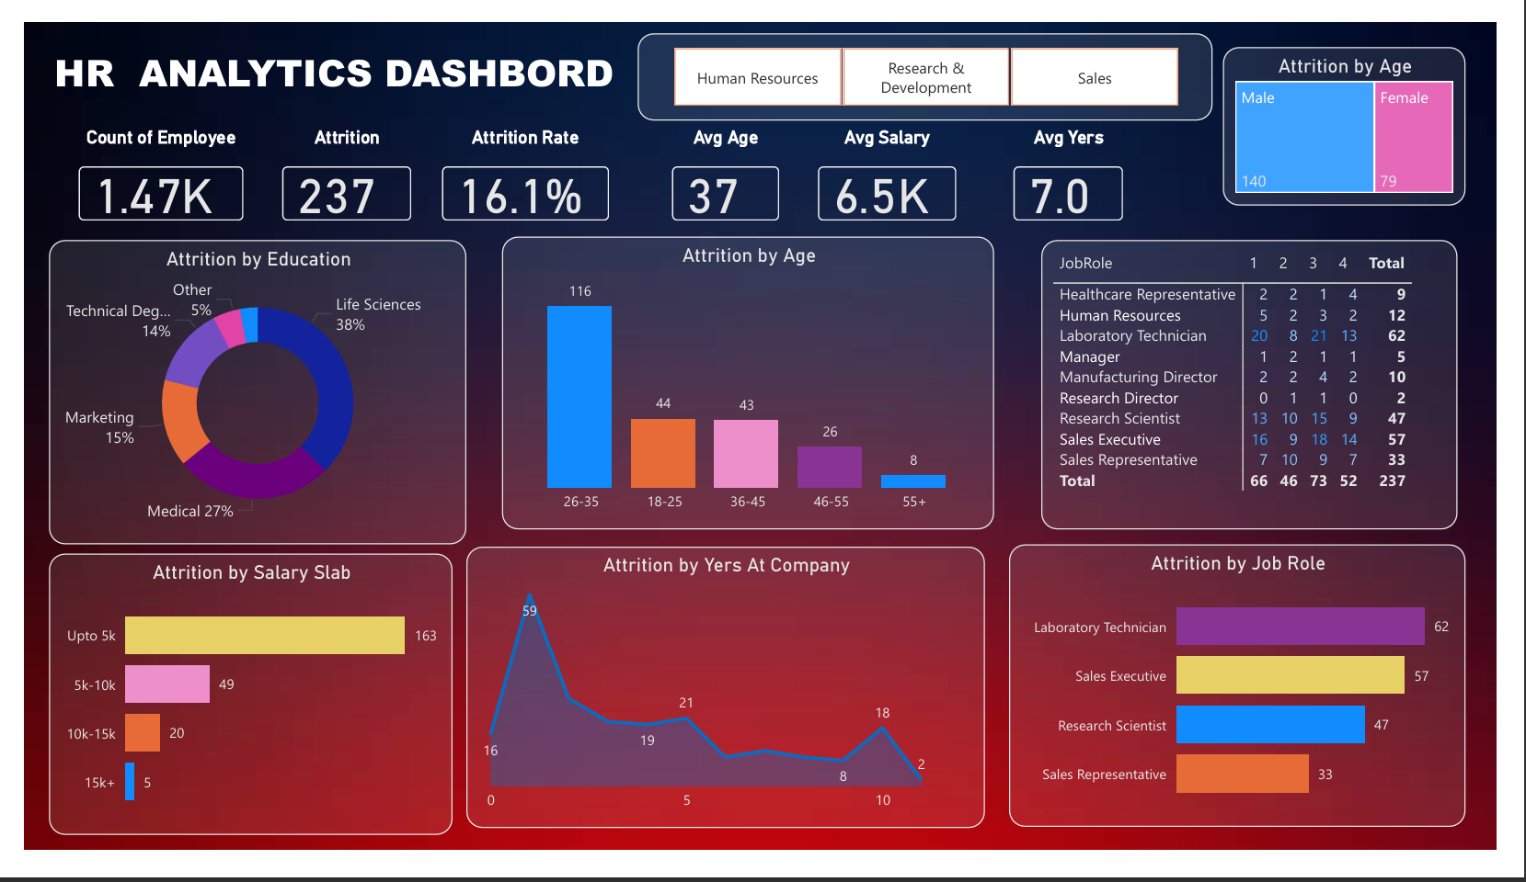
HR Analytics Dashboard – Power BI View

Slide 8

E-Commerce Sales Dashboard – Overview & Role
Overview
Interactive sales analytics dashboard built using Power BI
Objective: Track sales performance, profitability, and customer behavior
Helps business stakeholders monitor growth and revenue trends
Role:
Sales & profit analysis
KPI creation and visualization
Time-based performance analysis

Slide 9

E-Commerce Sales Dashboard – Key KPIs
Total Sales Amount: 438K
Total Profit: 37K
Total Quantity Sold: 5615 units
Average Order Value (AOV): 121K
Quarter-wise filtering for time-based analysis

Slide 10

E-Commerce Sales Dashboard – Business Insights
Sales analysis by state identifies top-performing regions
Category-wise quantity distribution shows customer preferences
Profit by month highlights profitable and loss-making periods
Payment mode analysis (UPI, COD, Credit/Debit cards)
Key Insights:
• Top-performing states identified
• Monthly profit and loss trends analyzed

Slide 11

E-Commerce Sales Dashboard – Skills Used
Skills
Power BI
Power Query (ETL)
DAX Measures
Sales & Profit Analysis
KPI Visualization
Business Analytics

Slide 12
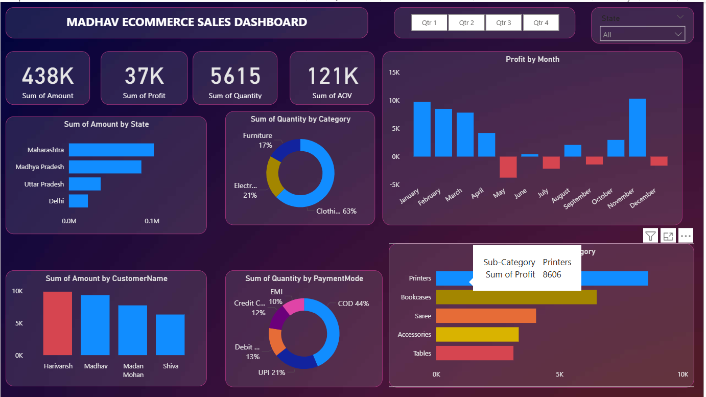
E-Commerce Sales Dashboard – Power BI View

Slide 13

Excel Analytics Dashboard – Overview & Role
Overview
Business analytics dashboard created using Microsoft Excel
Annual performance report for Vrinda Store (2022)
Demonstrates strong analytics capability using Excel
Role:
Data cleaning and preparation
Sales & customer trend analysis
Dashboard creation using Excel

Slide 14
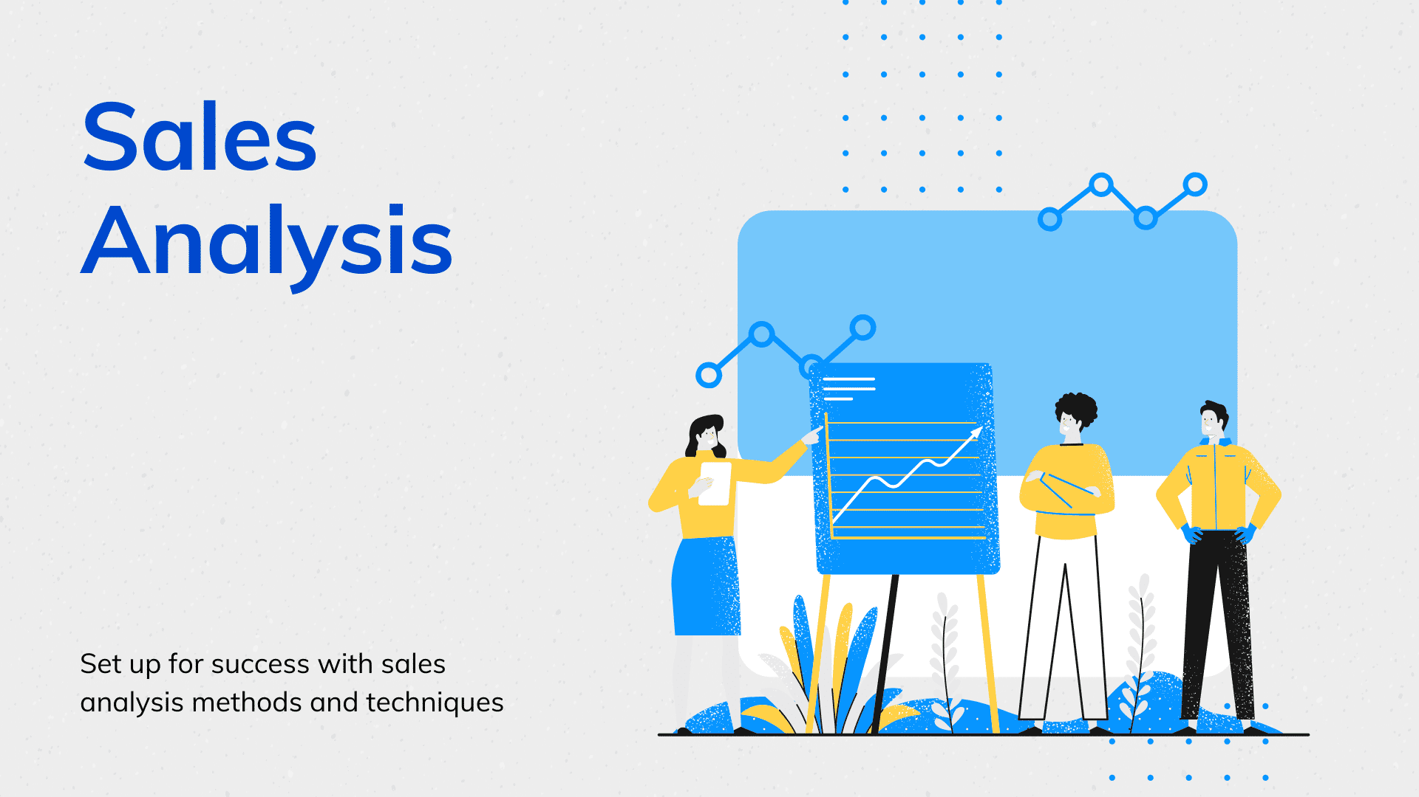
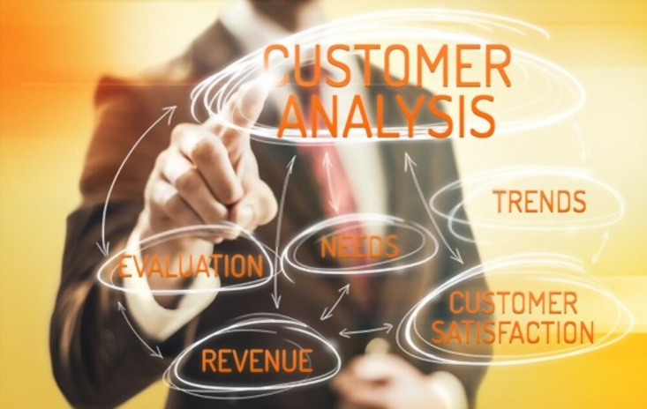
Excel Dashboard – Sales & Customer Analysis
Monthly Order vs Sales trend analysis
Sales contribution by gender (Men vs Women)
Order status analysis: Delivered, Returned, Refunded, Cancelled

Slide 15
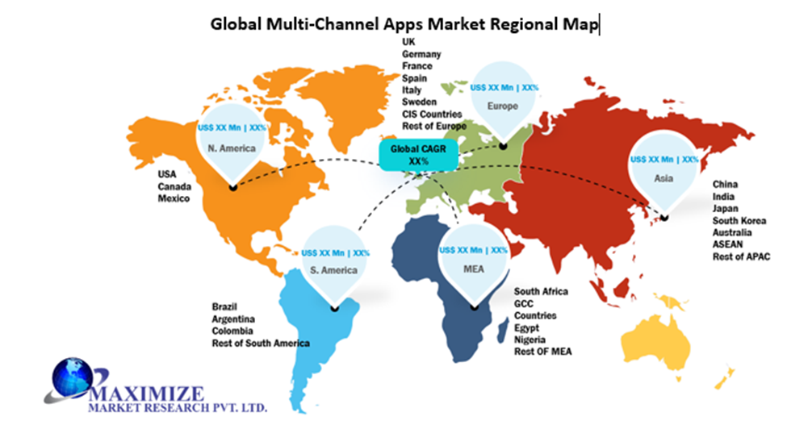

Excel Dashboard – Regional & Channel Insights
Top 5 states contributing to total sales
Customer segmentation by age group and gender
Order distribution across platforms (Amazon, Flipkart, Myntra, etc.)
Key Insights:
• Women customers contribute higher sales
• Top states drive maximum revenue

Slide 16

Excel Analytics Dashboard – Skills Used
Skills
Microsoft Excel
Pivot Tables & Charts
Advanced Excel Functions
Data Cleaning & Formatting
Dashboard Design
Sales & Customer Analytics

Slide 17
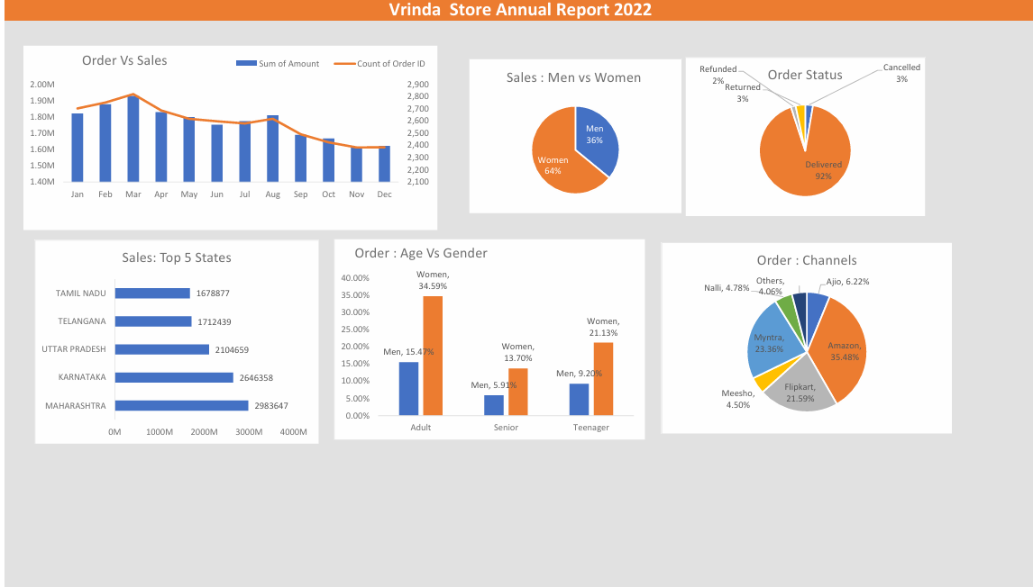
Excel Analytics Dashboard – View

Slide 18

Importance of Data Analytics & Stakeholder Communication
Data analytics helps organizations transform raw data into meaningful insights for informed decision-making.
Dashboards are effective only when insights are clear, relevant, and aligned with business objectives.
Stakeholder communication ensures that analytical insights are easily understood by both technical and non-technical users.
Well-designed visualizations and KPIs help stakeholders quickly identify trends, risks, and opportunities.
Effective communication bridges the gap between data analysis and actionable business decisions.

Slide 19

Conclusion
This portfolio demonstrates my ability to transform raw data into meaningful insights using Power BI and Microsoft Excel.
I have worked on real-world datasets to analyze HR attrition, sales performance, and customer behavior.
The dashboards focus on KPI tracking, trend analysis, and business decision support.
Through these projects, I strengthened my skills in data cleaning, Power Query, DAX, Excel functions, pivot tables, and data visualization.
I am motivated to apply these skills in entry-level Data Analyst or Power BI roles and continue learning in the analytics domain.

